Slide 1
OCAPPA MVP Training

Slide 2

AGENDA
What is an MVP?
Q & A, Resources & Next Steps
Introduction
Demonstration and Discussion
The Data Challenge in Facilities Management
Program Development

Slide 3

INTRODUCTION

Slide 4
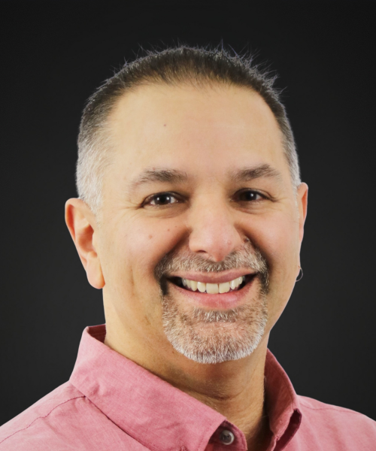
Ayden Townsend
Practice Leader, Data Management
30 Years of Expertise – Extensive experience in architecture, construction, training, and data analytics across public and private sectors.
Facility Management Leader – Led CAD standards, accessibility studies, CMMS selection, and facility condition assessments at TVDSB.
Strategic Capital Planner – Helps clients prioritize deferred maintenance and develop long-term capital plans.

Slide 5

Program Development

Slide 6
What is an MVP?
  Collaborative methodology used to developed a prioritization system that can be applied to existing building data
  Provides a numerical value between 0 and 100 for each recommendation/requirement your dataset as opposed to providing broad priority categories (e.g. Urgent, High, Medium, Low)
  Allows for rank ordering of each requirement
  Avoids having to ask “Which High is Higher than High”
  Allows organizations to integrate non-technical factors and other business priorities into the decision-making process
  Aligns with organizational vision, mission and values

Slide 7
Purpose
  To assist the Colleges in selecting specific Deferred Capital Renewal and Maintenance (DCRM) needs to implement as projects or programs, the Steering Committee proposed the development of a standard MVP calculation for 3-5 categories that will provide a specific numerical priority ranking for each study, repair or replacement recommendation.
  The model will also provide the ability to add 1-2 customized categories for each College, if desired.
  The development of the prioritization algorithm will be a collaborative effort between the Steering Committee, Roth IAMS and select Colleges who have already developed an MVP matrix.

Slide 8

Timelines
  March 2024
    Discussions began about having a consistent approach to establishing a priority matrix
    Demonstration was given to the OCAPPA steering committee on how SLAM could help
  April 2024
    A list was developed which contained all priority categories and scores for all Colleges that had independently established a framework

Slide 9

Timelines
  July 2024
    Work begins on developing draft list of standardized categories
  October 2024
    Session held (in person and online) to develop a list of priority categories for both assets and uniformat codes
    Steering committee hosted and invite those who had established MVPs to join

Slide 10
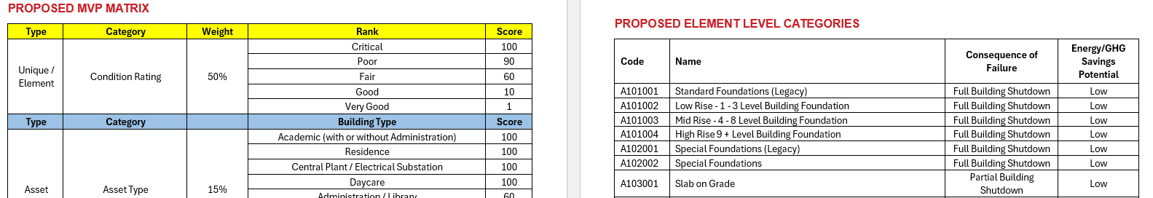
Timelines
  January 2025
    Complete list of categories, weights, ranks and scores and proposed selection criteria sent to steering committee to review
  February 2025
    MS Excel version of MVP sent to 5 Colleges to populate institutional data
  March 2025
    MVP scoring applied to data for 5 Colleges (MS Excel versions) and sent for review

Slide 11

Timelines
  August 2025
    College reviews underway
  November 2025
    Online meeting to review and finalize categories, ranks and scores
  December 2025
    Implementation in all College SLAM databases
    Training

Slide 12

THE DATA CHALLENGE IN FACILITIES MANAGEMENT

Slide 13

So much information, so little time (and money)
  Multiple asset types
  Multiple stakeholders
    Different priorities for each
  Limited Resources
    Money
    People
  “Everything” is urgent

Slide 14

MVP – Which High Is Higher Than High?

Slide 15

PICKING WHAT
GETS DONE?
Most organizations use categorical priority
  Urgent, High, Medium, Low
  What happens when you run out of money in the middle of a category?
  Which High Priority is Higher than High?
Next stage of evolution is typically
Risk-Based

Slide 16
Traditional Risk Management

Slide 17

Beyond Just Risk Management
More than just Risk to consider
in Capital Planning
What other factors do you consider?
  Impact to Users
  Asset Criticality (firehall vs. library)
  Sustainability/Energy Efficiency
  Code Compliance
  Community Needs
  Others?

Slide 18

Multivariable Prioritization (MVP)
How to do it?
SLAM CAP Software or Excel
Roth IAMS lead workshop
  Half-Day Workshop
  Include as wide a range of stakeholders as possible

Slide 19
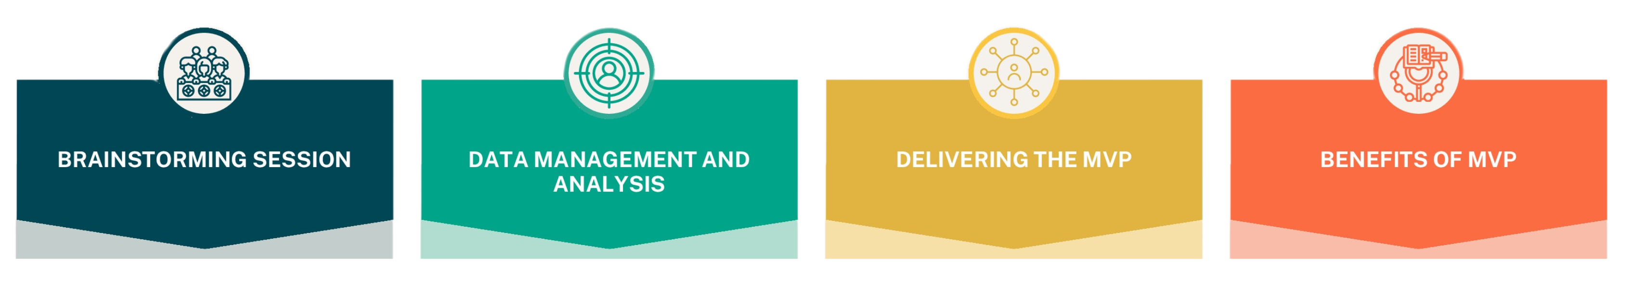
Multivariable Prioritization (MVP)
5-7 categories for prioritization
Weightings & scorings for each category
Buy in amongst stakeholders
Scoring 1-100 against recommendations
Capital planning tool
Decision making support
Slam Cap
Excel
Uniformat ll
Alignment amongst stakeholders
Transparency
Defensible Data

Slide 20
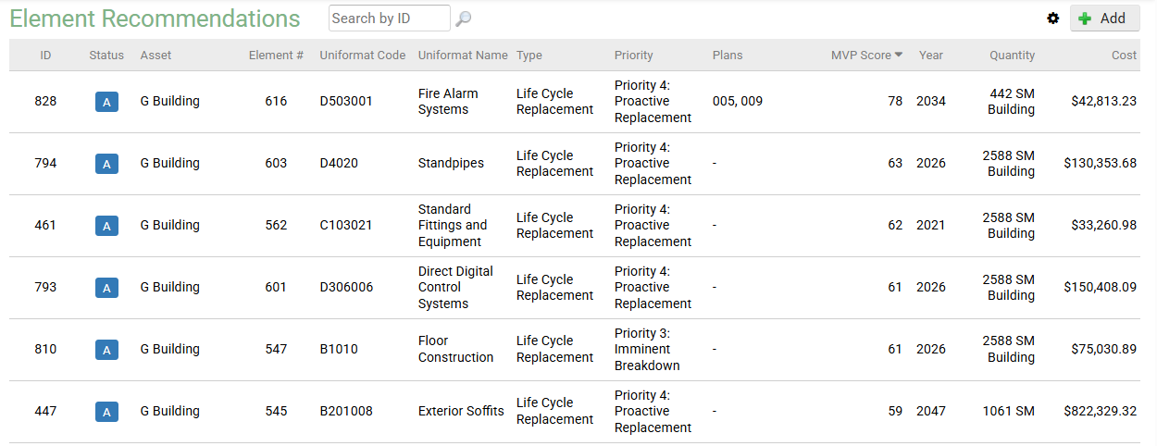
What you get?

Slide 21

What’s the catch?
None of this will work if you don’t have an effective strategy in place to acquire, manage and update consistent and defensible asset data on a regular basis
  Not a Decision Making Tool
    There are always going to be reasons to override the MVP
    Requires time & investment into data collection
    Requires engagement of all stakeholders/departments

Slide 22
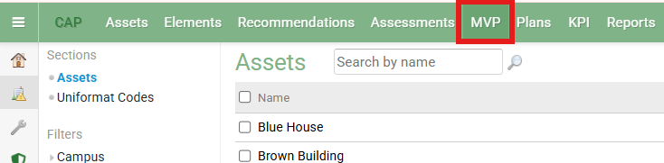
Demonstration

Slide 23

Q & A

