Slide 1
Ventilation, Air Filtration, and COVID-19
“Avoiding the Snake Oil Salesman”
OCFMA Presentation
June 3, 2021
Francis (Bud) J. Offermann PE CIH
Indoor Environmental Engineering
San Francisco, CA
(415)-567-7700
www.IEE-SF.com
Offermann@IEE-SF.com

Slide 2

Ventilation and Air Filtration and Airborne Transmission of SARS-CoV-2
“The Role of Building Ventilation and Filtration in Reducing Risk of Airborne Transmission in Schools, Illustrated with SARS-CoV-2”, September 1, 2020
Available at /www.cdph.ca.gov/Programs/CCDPHP/DEODC/EHLB/IAQ/Pages/Airborne-Diseases.aspx

Slide 3
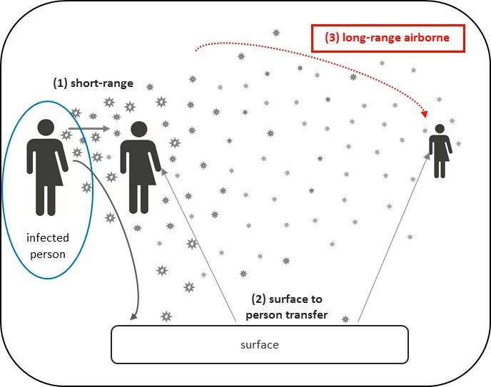
Ventilation and Air Filtration and Airborne Transmission of SARS-CoV-2

Slide 4
Ventilation and Air Filtration and Airborne Transmission of SARS-CoV-2
Removal mechanisms of airborne SARS-CoV-2 virus:
outdoor air ventilation
air filtration (HVAC and portable air cleaners (PAC)
ACH_{Total} = ACH_{OA} + ACH_{HVAC-Filtration} + ACH_{PAC}

Slide 5
Ventilation and Air Filtration and Airborne Transmission of SARS-CoV-2
It is important to recognize that while outdoor air ventilation and air filtration can reduce the risk of far field airborne exposures to SARS-CoV-2 (e.g., greater than 6 feet), no amount of ventilation or air filtration can reduce risk of close exposure to an infected individual, only masks and so social distancing can reduce this risk.

Slide 6
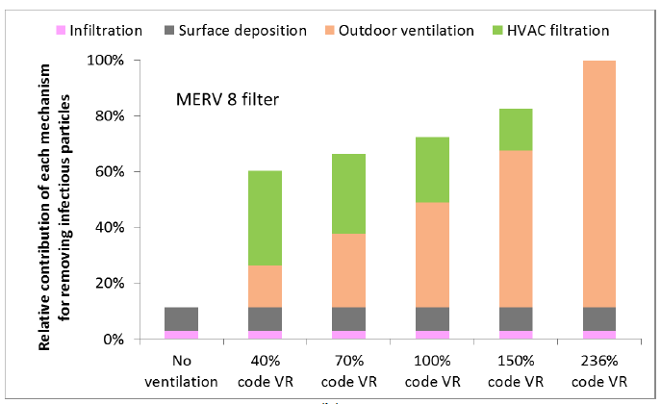
Ventilation and Air Filtration and Airborne Transmission of SARS-CoV-2

Slide 7
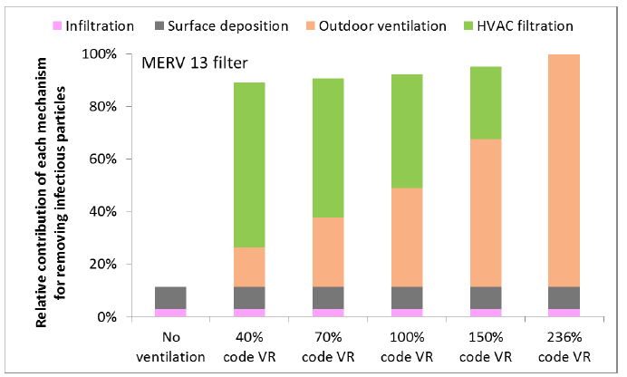
Ventilation and Air Filtration and Airborne Transmission of SARS-CoV-2

Slide 8
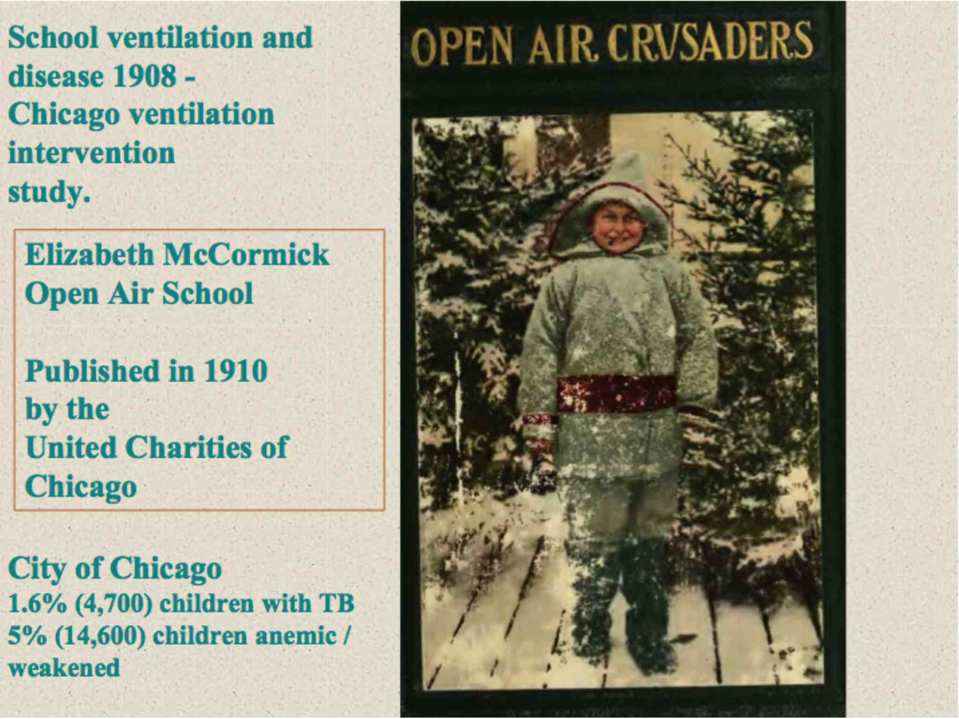
Ventilation and TB in 1910

Slide 9
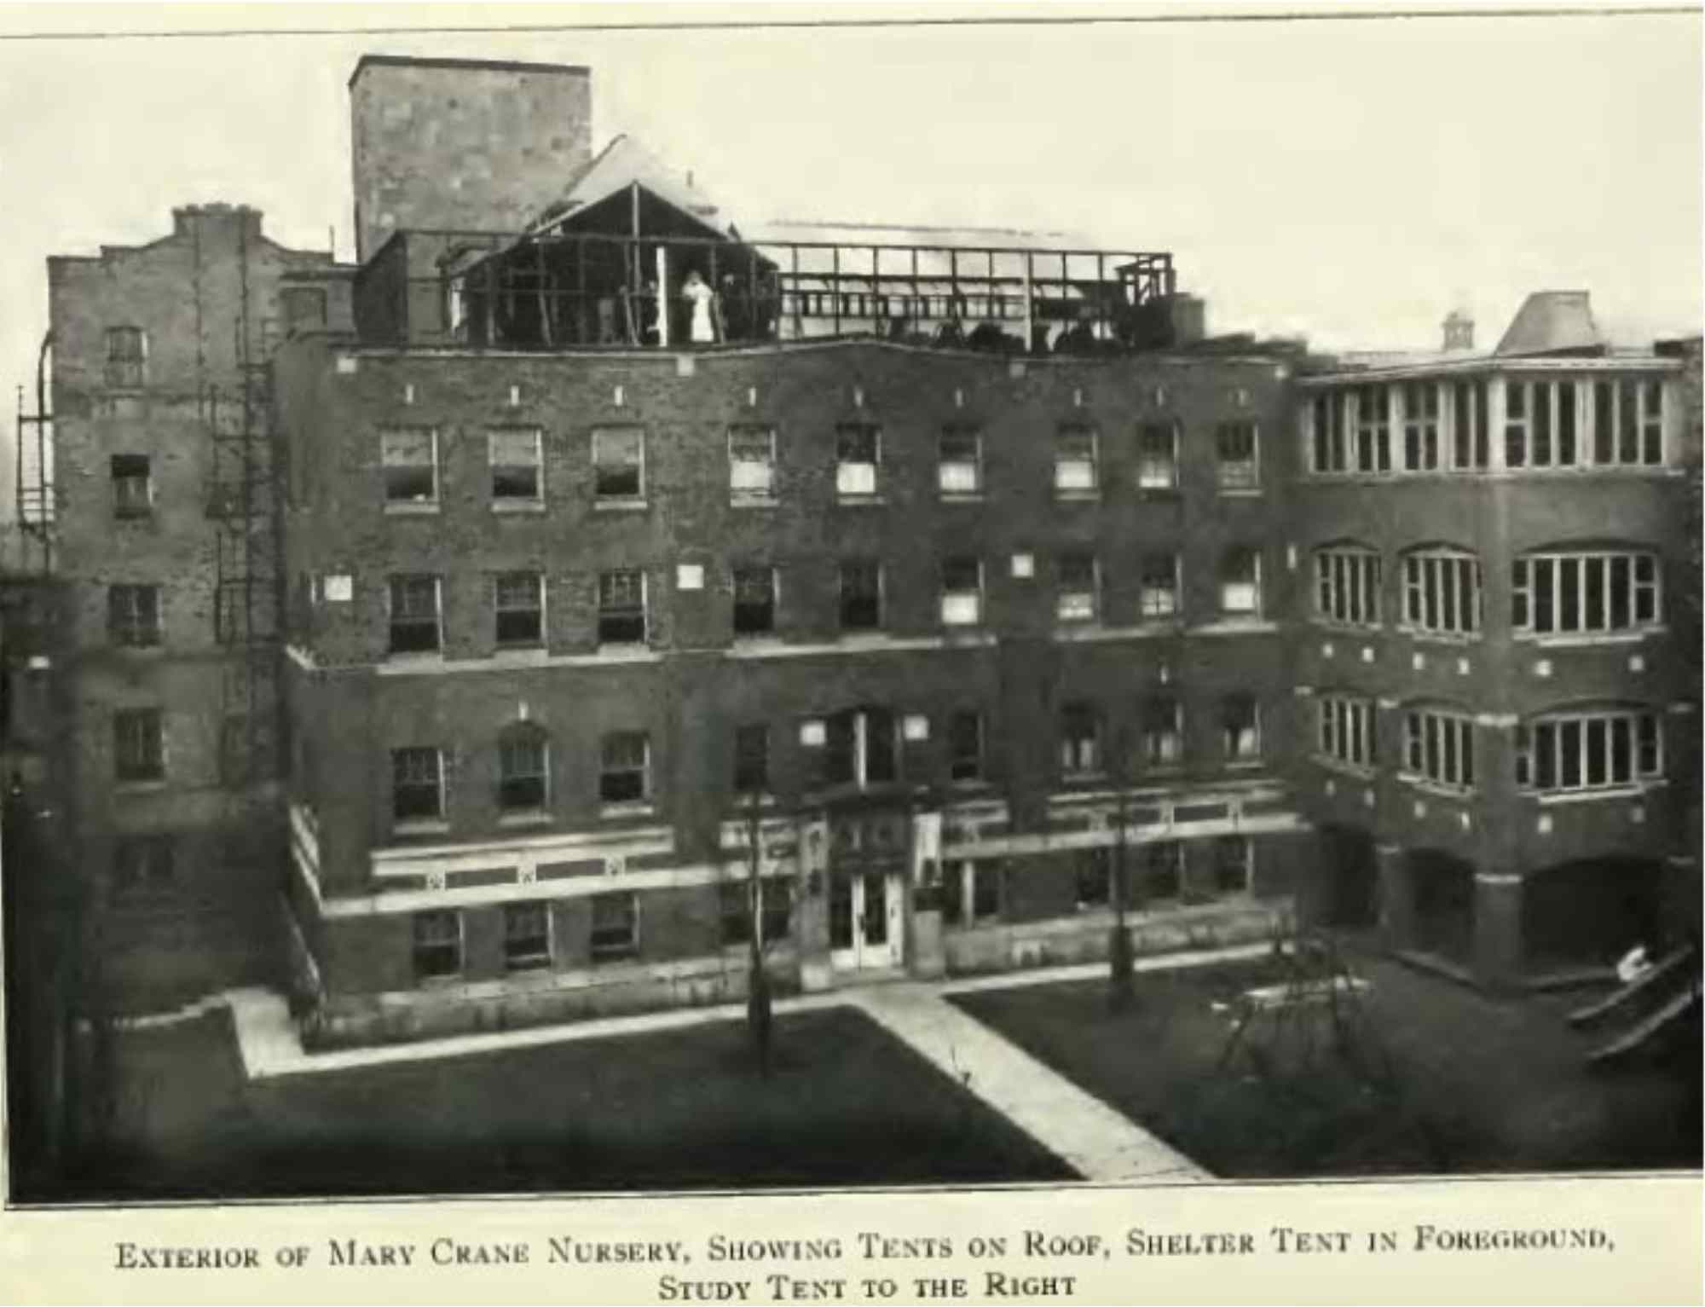
Ventilation and TB in 1910

Slide 10
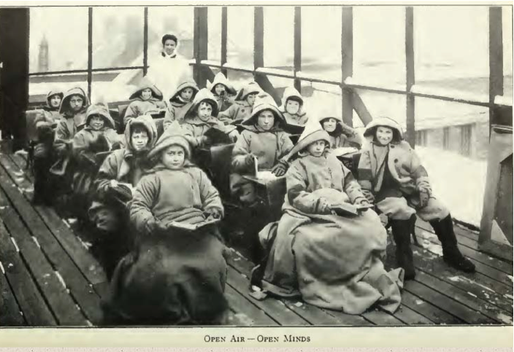
Ventilation and TB in 1910

Slide 11
Types of Air Filtration/Cleaning Devices
Mechanical Filters (fibrous media; without or with electrostatic charge)
Panel
Extended surface (pleated)
Electrostatic Precipitators
Ionizers
Negative
Bipolar
UV and Photo-catalytic Oxidization (PCO)

Slide 12
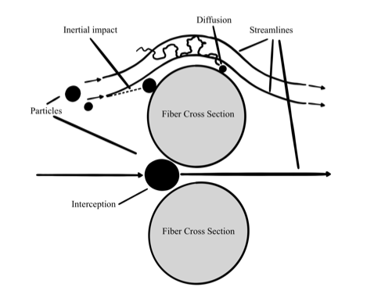
Mechanical Filtration Removal Forces

Slide 13
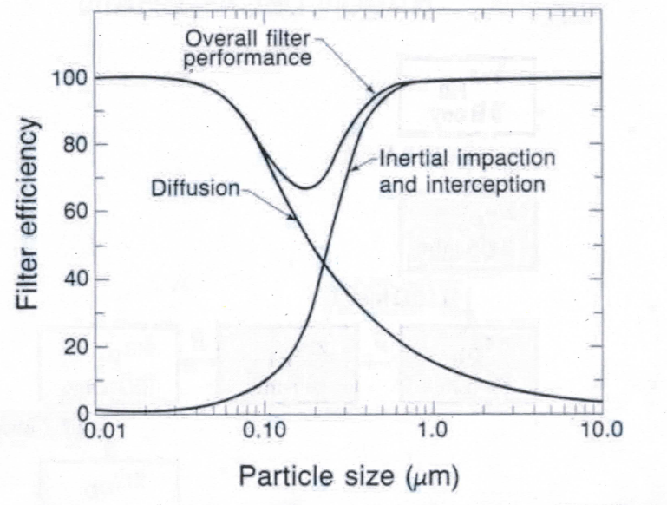
Mechanical Filtration Removal – Particle Size

Slide 14
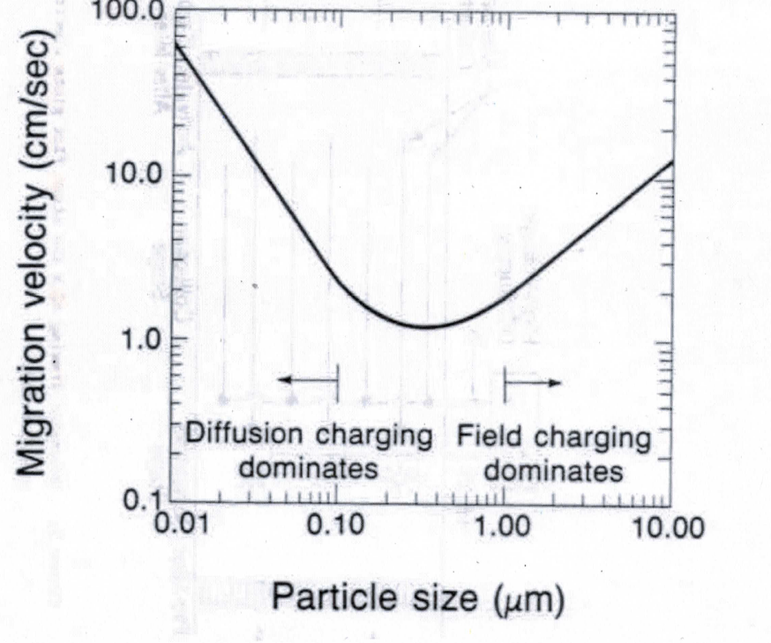
Electrostatic Precipitator Removal – Particle Size

Slide 15
HVAC Air Filtration and Portable Air Cleaner Performance Testing
HVAC Air Filtration
ASHRAE 52.2 – MERV Rating
Upstream and downstream measurement of particle concentrations. Ducted single pass test.
Portable Air Cleaners (PACs)
AHAM AC-1 – Clean Air Delivery Rate (CADR)
Chamber test of particle removal rate with and without PAC.

Slide 16
Air Filtration /Air Cleaning
What Works
Extended surface (pleated) fibrous air filters with an ASHRAE MERV rating
Portable air cleaners with an AHAM AC-1 Clean Air Delivery Rate (CADR) ratings for tobacco smoke.
Carbon dioxide (CO₂) sensors provide real time feedback regarding the delivery of outdoor air per person. Especially useful in classrooms without a mechanical supply of outdoor air (e.g. openable windows).

Slide 17
Air Filtration /Air Cleaning
Air filtration and air cleaning device to be avoided:
Those that do not have an ASHRAE MERV or AHAM AC-1 Clean Air Delivery Rate (CADR) rating.
Do not use air filters or portable air cleaners that utilize electrostatics, ultraviolet light (UV), ozone, or photo-catalytic oxidation (PCO).
Most of these devices do not have test data showing they provide any significant removal of indoor air contaminants, and some may produce harmful chemicals such as formaldehyde and ozone.

Slide 18
Air Filtration /Air Cleaning
Recent research on air cleaners utilizing negative ions suggests possible adverse health effects.
“Negative ions offset cardiorespiratory benefits of PM_{2.5} reduction from residential use of negative ion air purifiers”. 2020. Indoor Air Journal. Wei Liu et. al.
Observed association between negative ion exposure and increased systemic oxidative stress.

Slide 19

Avoiding the Snake Oil Salesman
The Snake Oil Salesman (Morgan Weistling)

Slide 20
Government Regulations for Air Filtration and Air Cleaning
Federal Trade Commission (FTC) and
Consumer Safety Product Commission (CPSC)
WHERE ARE THEY ?
CONSUMERS are being mislead by the “false advertising” that these devices provide absolute protection and encourage users to discontinue use of masks and social distancing indoors.
The false sense of security posed by these advertising claims are putting people’s lives at risk

Slide 21
Ventilation and Air Filtration and Airborne Transmission of SARS-CoV-2
It is important to recognize that while outdoor air ventilation and air filtration can reduce the risk of far field airborne exposures to SARS-CoV-2 (e.g., greater than 6 feet), no amount of ventilation or air filtration can reduce risk of close exposure to an infected individual, only masks and so social distancing can reduce this risk.

Slide 22
Managing Indoor Concentrations of
Wildfire Smoke in Classrooms
During the COVID-19 Pandemic
Managing indoor concentrations of wildfire smoke during the COVID-19 pandemic presents a unique challenge to building operators and engineers.
To minimize indoor concentrations of wildfire smoke, it is desirable to minimize the amount of outdoor air delivered to a classroom.
However, to minimize indoor concentrations of the COVID-19 virus, SARS-CoV-2, it is desirable to maximize the outdoor air delivered to a classroom.

Slide 23
Managing Indoor Concentrations of
Wildfire Smoke in Classrooms
During the COVID-19 Pandemic
Outdoor air ventilation rates should be set to the code-required minimum and NOT to zero ventilation (which would occur if the outdoor air dampers were closed
or the outdoor air inlet was sealed or obstructed).
The air filters in the ventilation systems should be rated at least MERV 13.
For ventilation systems with outdoor air economizers, these controls need to be disabled during times with wildfire smoke.
Portable air cleaners can be used to assist in controlling the indoor air concentrations of wildfire PM_{2.5} and SARS-CoV-2.

Slide 24
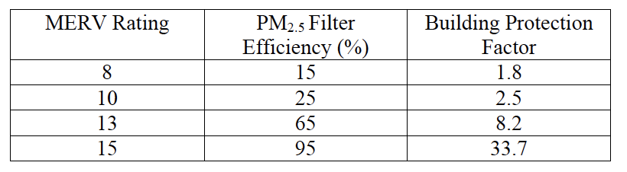
Managing Indoor Concentrations of
Wildfire Smoke in Classrooms
During the COVID-19 Pandemic
Building Protection Factor (BPF), which describes how much protection is provided from the outdoor air
concentrations of PM2.5 particulate matter.
BPF = C_{outdoors}/C_{indoors}
BPF for office and schools.

Slide 25
??? QUESTIONS ???
Francis (Bud) J. Offermann PE CIH
Indoor Environmental Engineering
San Francisco, CA
(415)-567-7700
www.IEE-SF.com
Offermann@IEE-SF.com

