Slide 1


2018 to 2020
DENTAL LAB RENOVATION
June 2021
FACILITY PLANNING & DEVELOPMENT

Slide 2
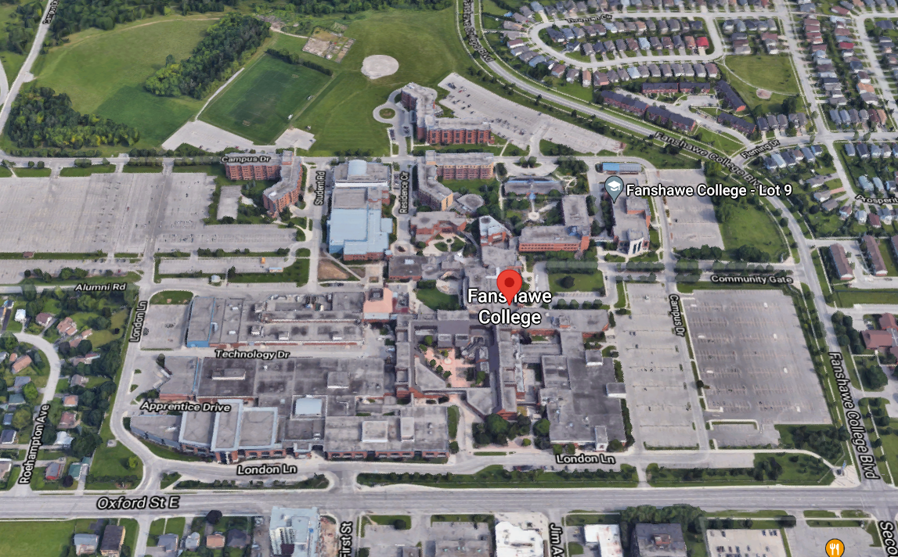

Oxford Street Campus
New
Dental Clinic

Slide 3
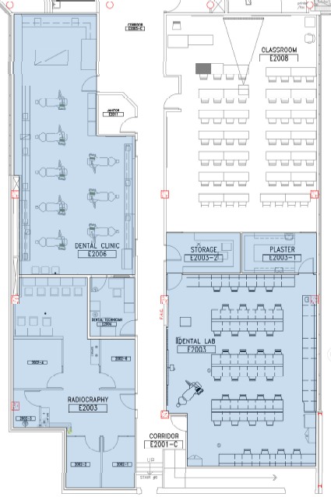
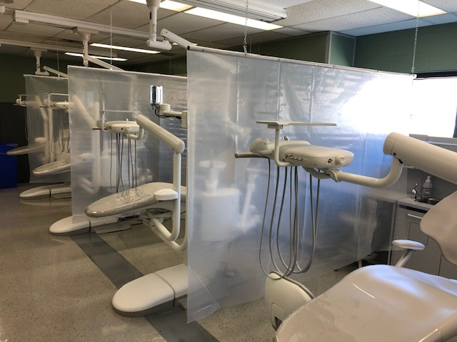
Existing Space
Original Location:
2nd floor of E building
No direct outside access
3300sf of dedicated space
Clinic – 8 chairs
Radiography -4 xray rooms

Slide 4
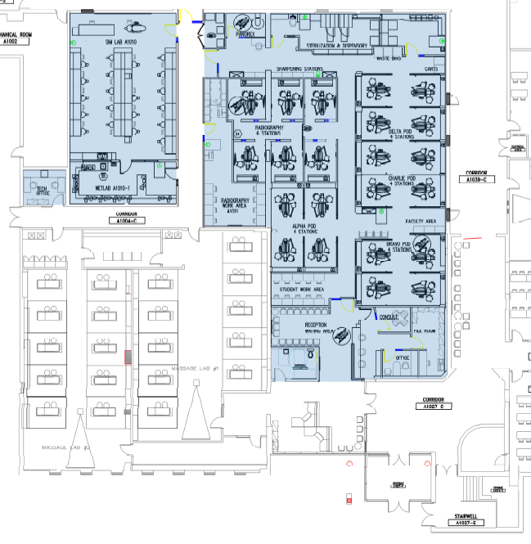
Renovated Space
Renovated Location:
1st floor of A building
Direct access from outside
Meter parking & Bus stop adjacent
8083sf of dedicated space
Clinic – 16 chairs
Radiography -6 operatory plus 1 pano machine
Renovated Area - 8,083 sf / 751 sm
Total Project Cost - $6.8M
Project Budget - $7.35M
Square Foot Cost - $841.27
Square Meter Cost - $9,054.00
Equipment (and design assistance) by Henry Schein ~ $2.4M budget
Client based Software NIC

Slide 5
Renovated Space
Video | YouTube Video presentation of the new Dental Clinic https://youtu.be/uvTjlzWA6fg
Intro by President Devlin | As a College we have had our own challenges during the pandemic. We are very pleased that Fanshawe has been able to continue construction during the last year, allowing us to move forward with our campus improvements. It hasn’t been easy, but this beautiful state-of-the-art facility is a prime example of how the College has updated its facilities for current and future students. We are committed to excellence in education and contributing to the health and wellbeing of our community. This clinic is a learning lab for our students – it will allow them to hone their skills
Article | https://www.fanshawec.ca/about-fanshawe/news/fanshawe-opens-new-oral-health-clinic

