Slide 1
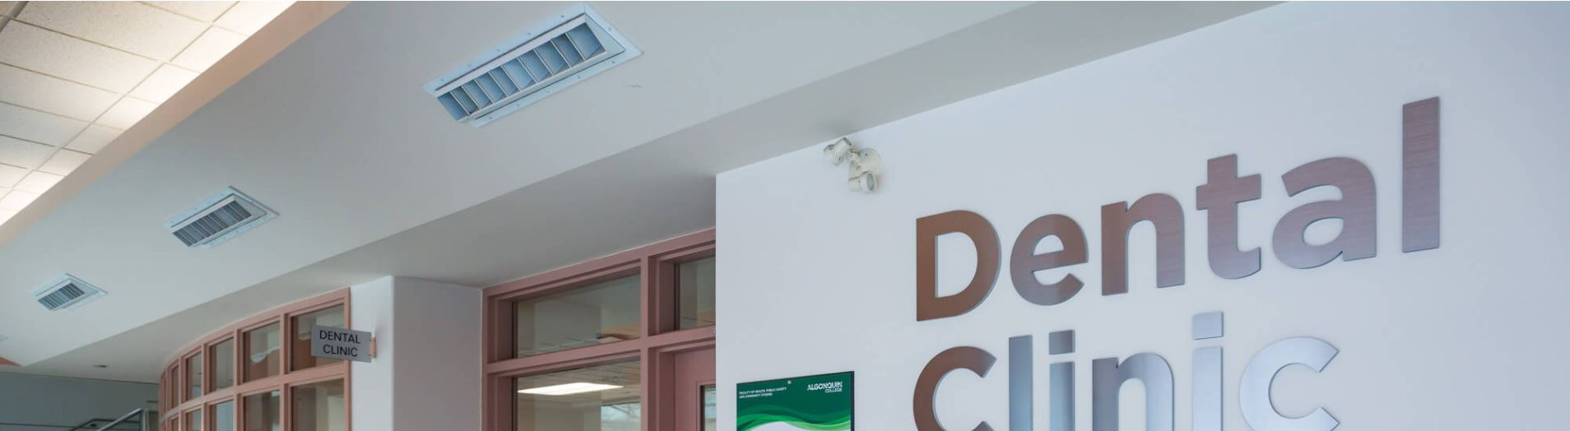

Dental Lab Renovations
Presentation
June 14, 2021

Slide 2

Contents
Dental Program at Algonquin College
Existing Dental Clinic
Requirements
Options
Construction Delivery
Completed Renovations
Project Schedule
Budget & Final Cost
Lessons Learned
2
Notes:
VV to DM

Slide 3
1. Dental Program
Three-year Dental Hygiene Ontario College Advanced Diploma Program
Accredited by the Commission on Dental Accreditation of Canada
Allows Registration with College of Dental Hygienists of Ontario
Theory and hands-on components of curriculum
Provision of preventative services at Algonquin College on-campus dental clinic
Supervised by Registered Dental Hygienists and Dentists
3
Notes:
VV to DM

Slide 4
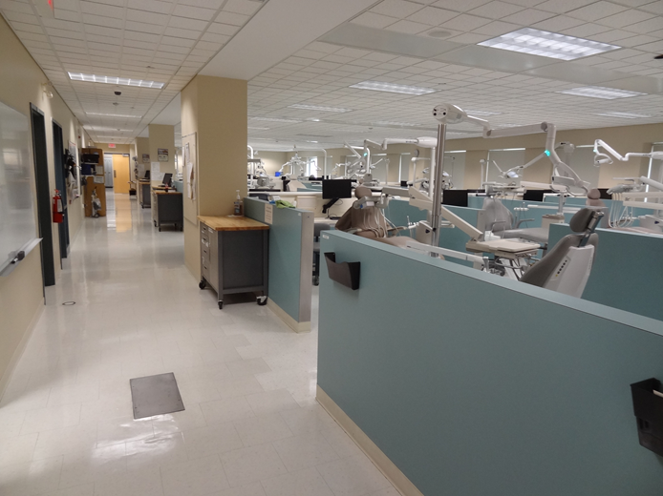
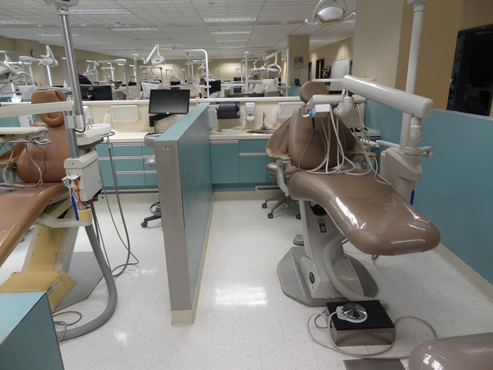
2. Existing Dental Clinic
Large common area
Individual treatment spaces (32)
Current equipment & technology
Shared HVAC system & lighting
Narrow corridors
High utilization by program
High demand for services
4
Notes:
VV to DM

Slide 5
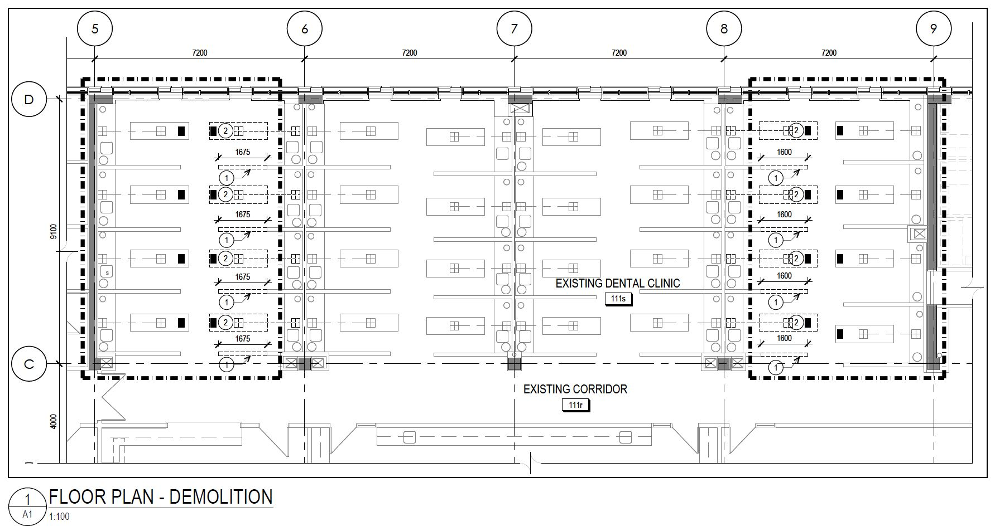
2. Existing Dental Clinic
5
Notes:
VV to DM

Slide 6
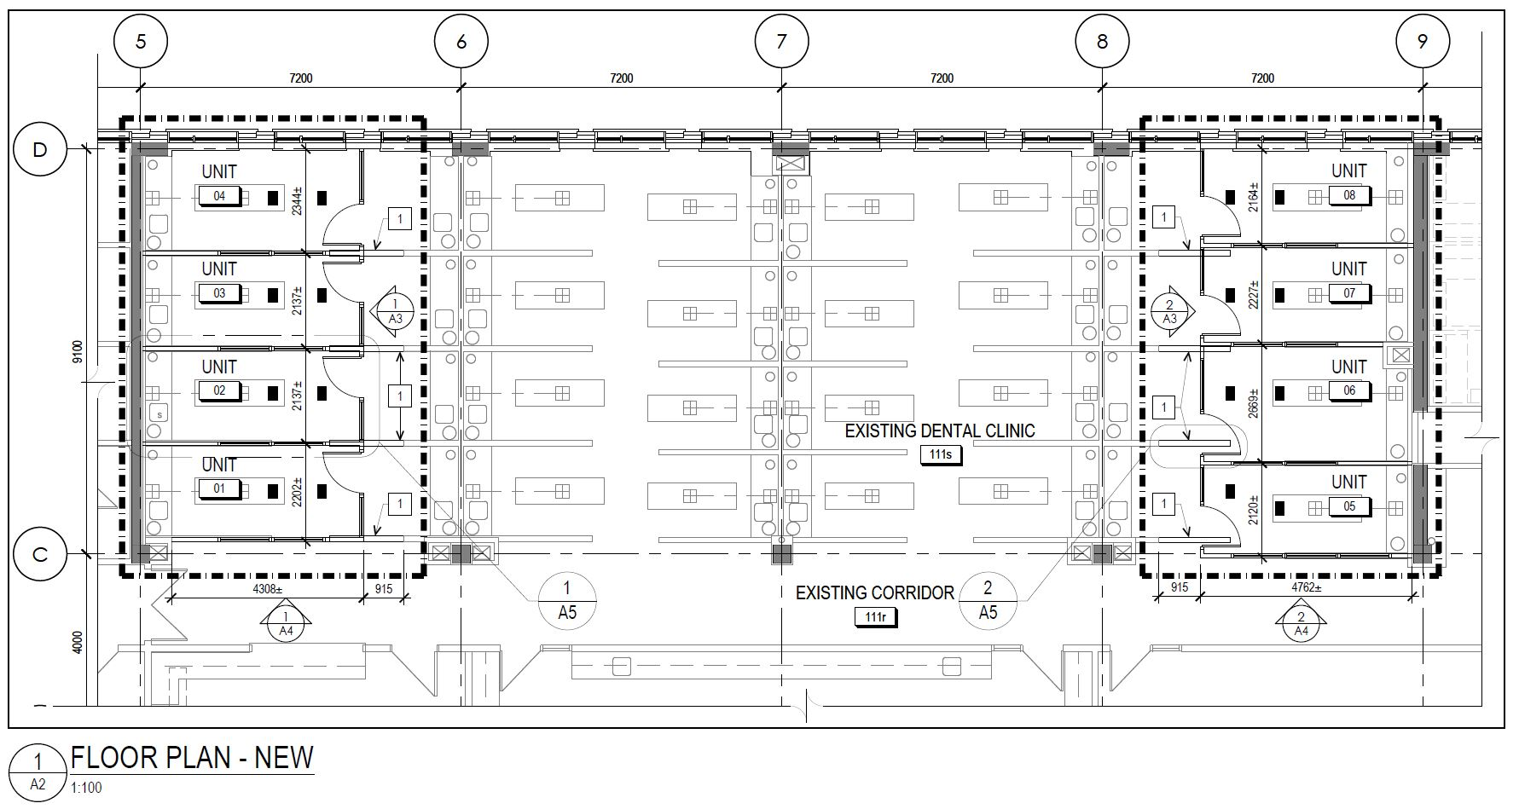
2. Existing Dental Clinic
6
Notes:
VV to DM

Slide 7
3. Requirements
Needed for program continuity
Meet COVID-19 health guidelines
Individual / separated treatment spaces (8)
Separate air handling / filtration (9ACH enclosed vs 6ACH open)
Easily sanitized spaces
Mid-term solution (2 years)
Limit impact of construction on adjacent spaces
Budget constraints
Schedule constraints
7
Notes:
VV to DM

Slide 8
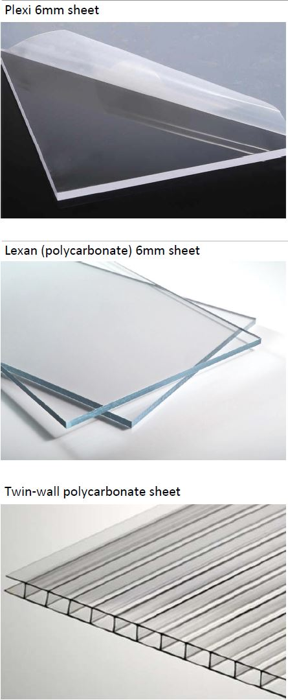
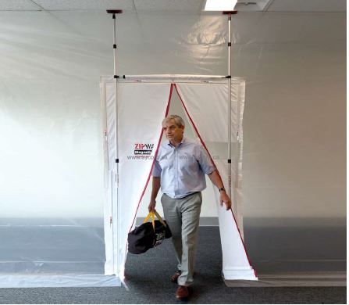
4. Options
Rigid Sidewall
Materials
ZipWall (Plastic sheet) with Magnetic Strip Doors
  Relatively quick and least expensive
  Limited durability and difficult to clean
  Impact to professional look of Dental Clinic
Rigid Sidewalls with Magnetic Strip Doors
  Some assembly required in aluminum frame
  Moderately expensive but available within schedule
  Easier surface cleaning
ZipWall
8
Notes:
VV to DM

Slide 9
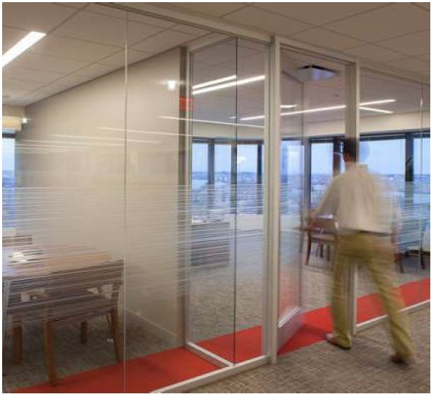
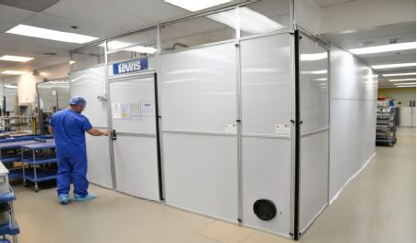
4. Options
Edge Guard System (Doors & Side Walls)
Aluminum frame, preassembled panels, reusable
Conventional and well understood from design perspective
Available from US but expensive
PC350 Partitions (doors & Side Walls)
Conventional and well understood from design perspective
Delivery timelines exceeded schedule
Expensive for mid-term solution
PC350
Edge Guard
9
Notes:
VV to DM

Slide 10
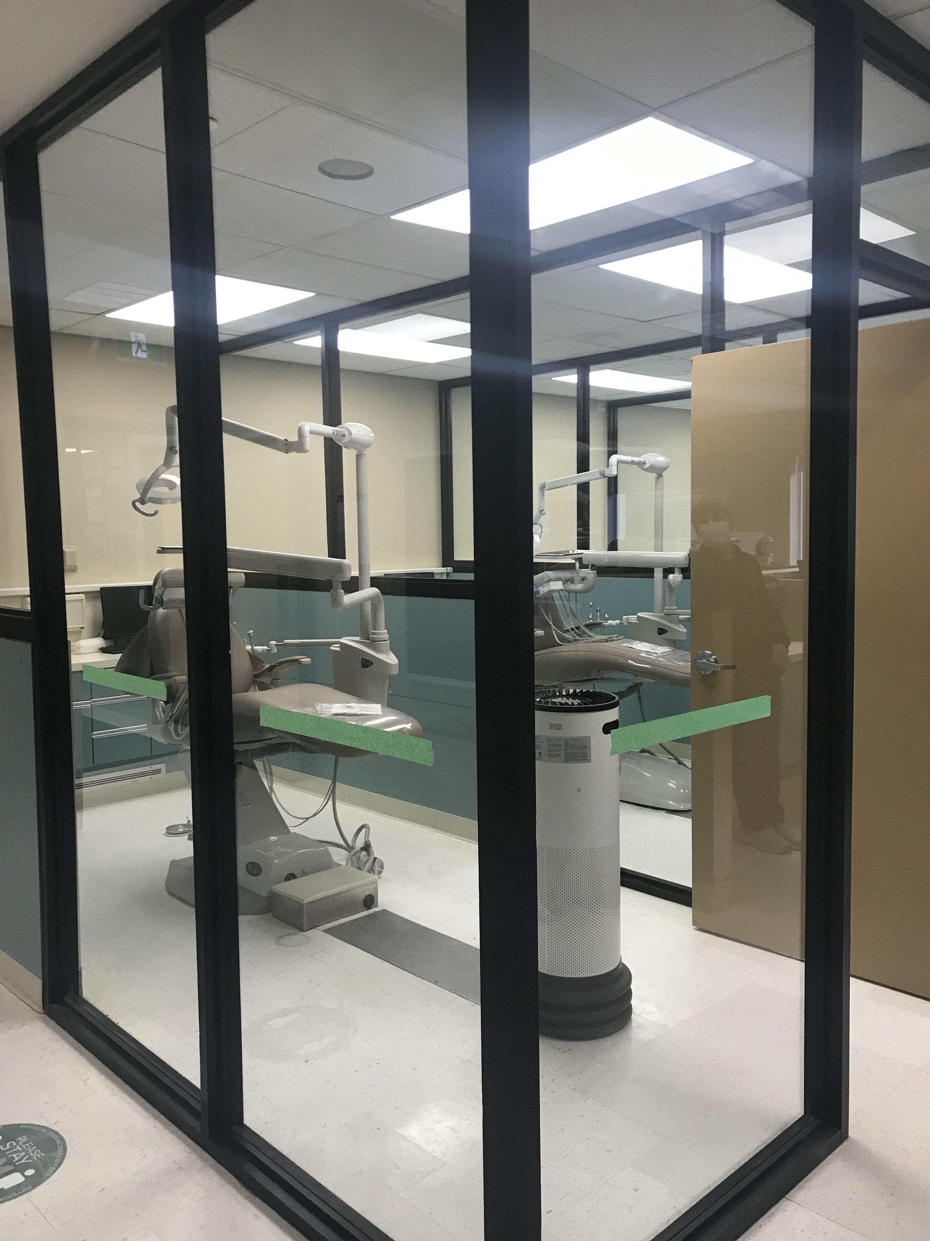
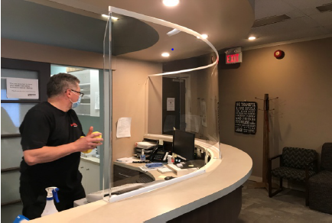
4. Options
Canus Plastic Sidewalls with Plastic Doors
Conventional and well understood from design perspective
Moderately priced with intermediate delivery times
Options for different materials in aluminum frames
Wood Frame & Glass Assembly (Selected)
Painted wood with tempered glass inserts
Readily available and constructable
Met schedule and budget
Proposed by construction manager
Wood Frame
Canus
10
Notes:
VV to DM

Slide 11
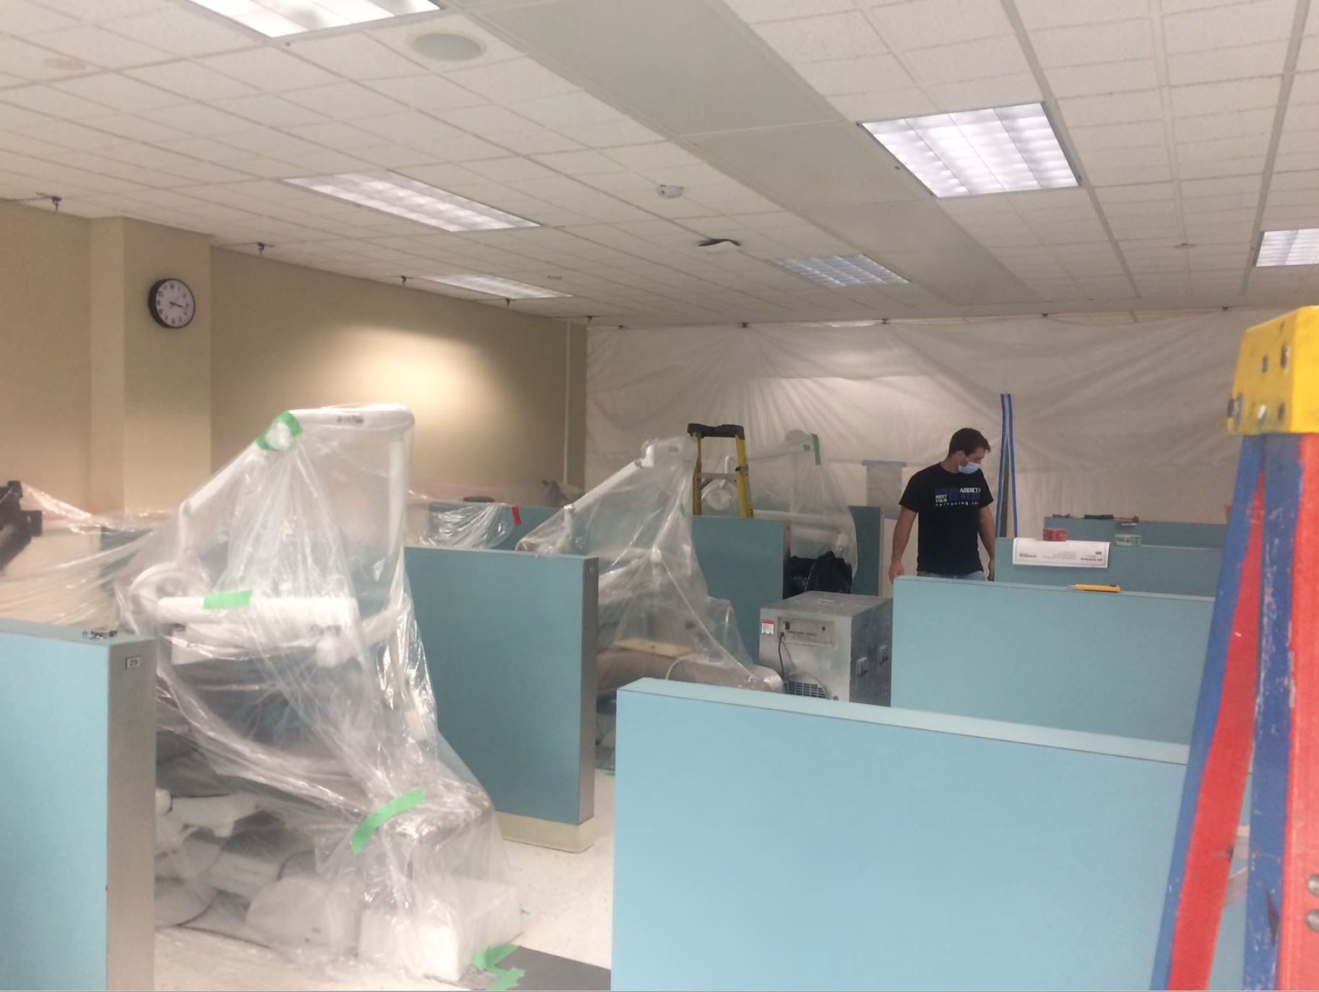
5. Construction Delivery
Collaborative with Construction Manager (CCDC-5B)
Phased with clinic operations*
Local fabrication of partitions
Easily customized to existing partitions
Modification to HVAC systems
Modification to lighting
Individual air purification units
11
Notes:
VV to DM

Slide 12
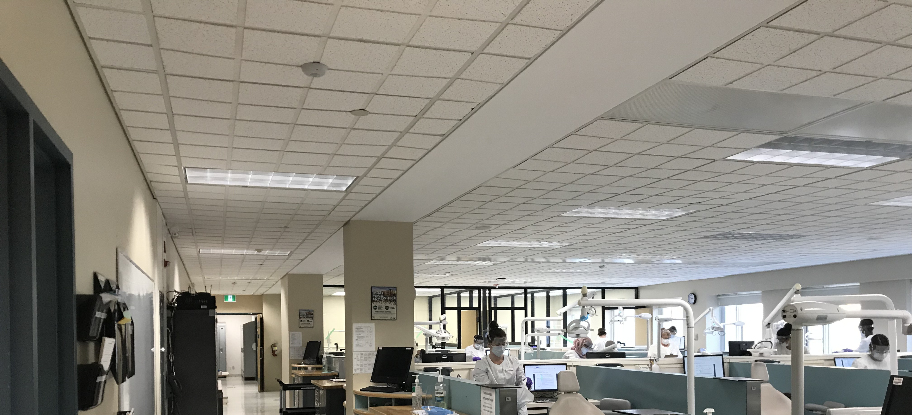
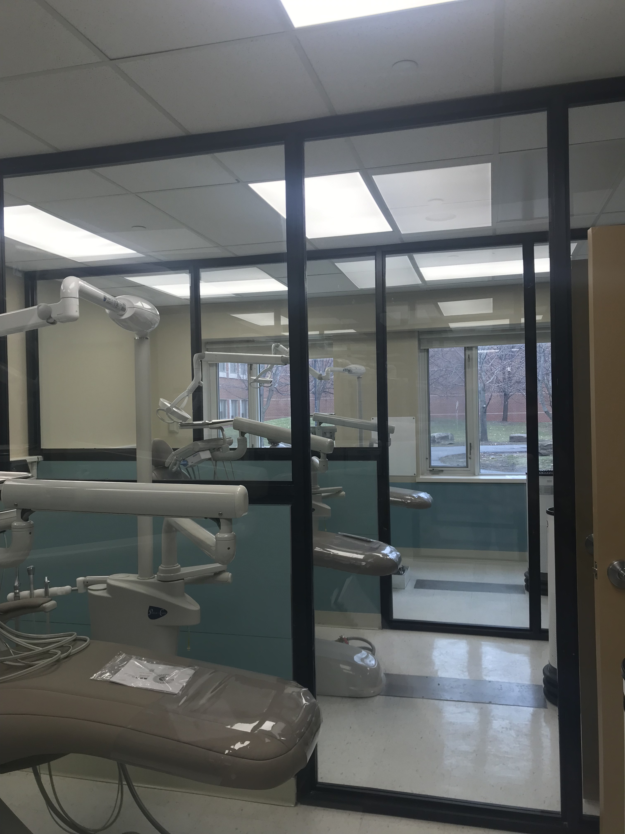
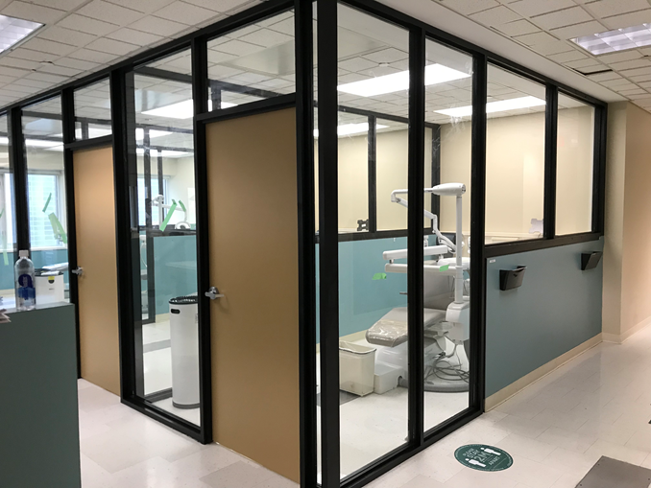
6. Completed Renovations
12
Notes:
VV to DM

Slide 13
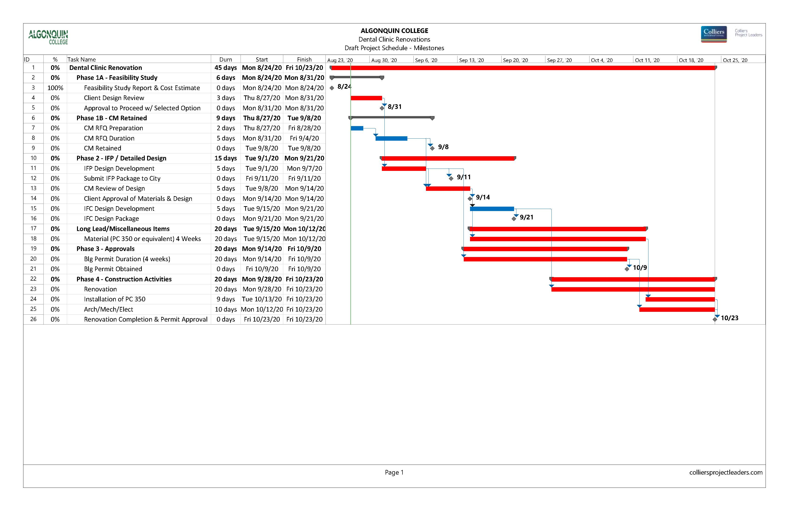
7. Project Schedule (Original)
Feasibility Study 1 week
Design, Permits & CM Procurement 3 weeks
Construction 4 weeks
13
Notes:
VV to DM

Slide 14
8. Project Budget
Soft Costs $ 45,850
Construction $ 165,345
HVAC & Controller Upgrade $ 73,421
JADE Air Handling Units (8) $ 14,660
Annual Maintenance (per unit) $ 100
14
Notes:
VV to DM

Slide 15
9. Lessons Learned
Involve everyone to understand requirements – needs & wants
Remain flexible to potential solutions
Construction management approach
Include trades in solution development
Enhance existing base building systems, deferred maintenance
Include adequate contingencies – cost and schedule
Designate individual to oversee project delivery
15
Notes:
VV to DM

Slide 16
Thank You
Questions?
16
Notes:
VV to DM

