Slide 1

_______________
Dental Clinic Project
January 2021
_______________

Slide 2
Dental Clinic Project
2 objectives of the Dental Clinic’s renovations:
Replacement of pipes and suction system
  Due to the end of life of the components
  Disintegration Original type of piping
  Addition of dedicated permanent cubicle and ventilation, due to new standards:
    Ventilation System (LAN CHI la raison exacte)
    HEPA unit in each cubicle
    Permanent cubicle adapt for ODA

Slide 3
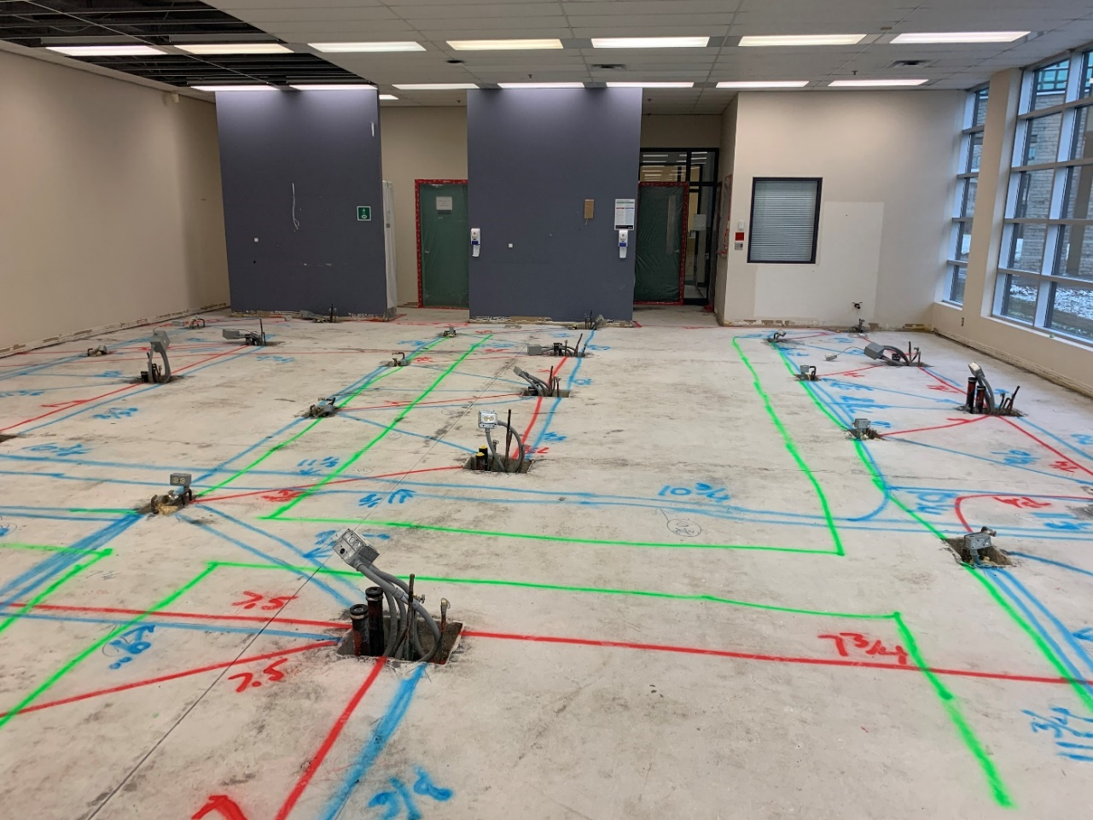
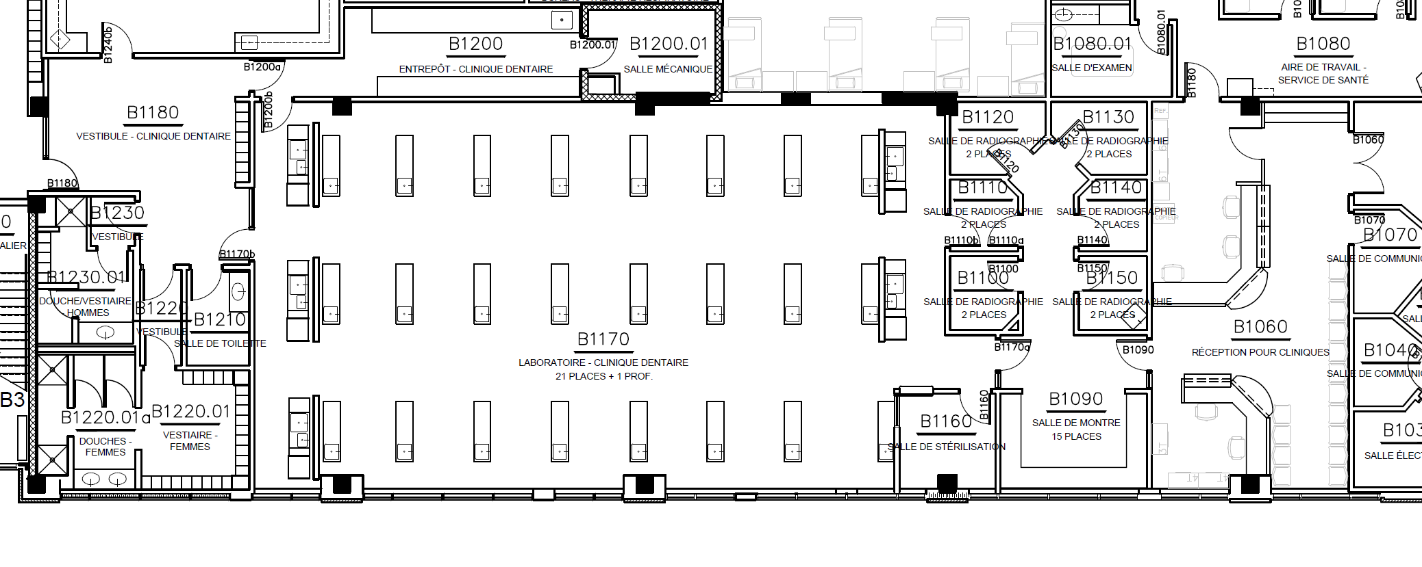
Dental Clinic Project
Original layout (21 station)

Slide 4
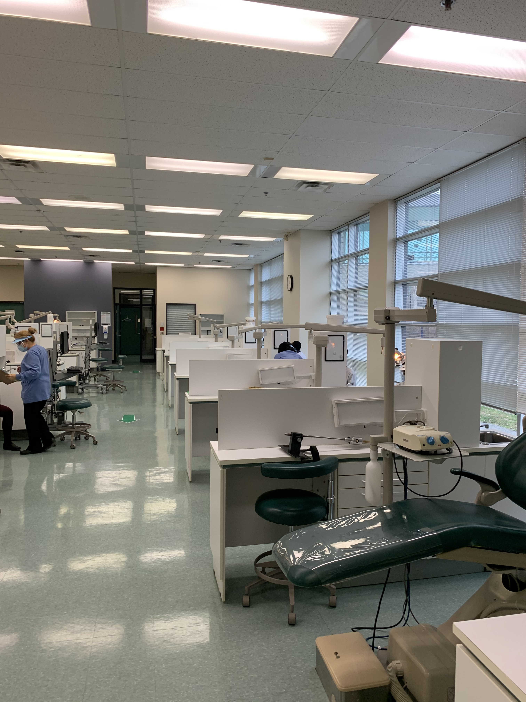
Dental Clinic Project
Original layout (21 station)

Slide 5
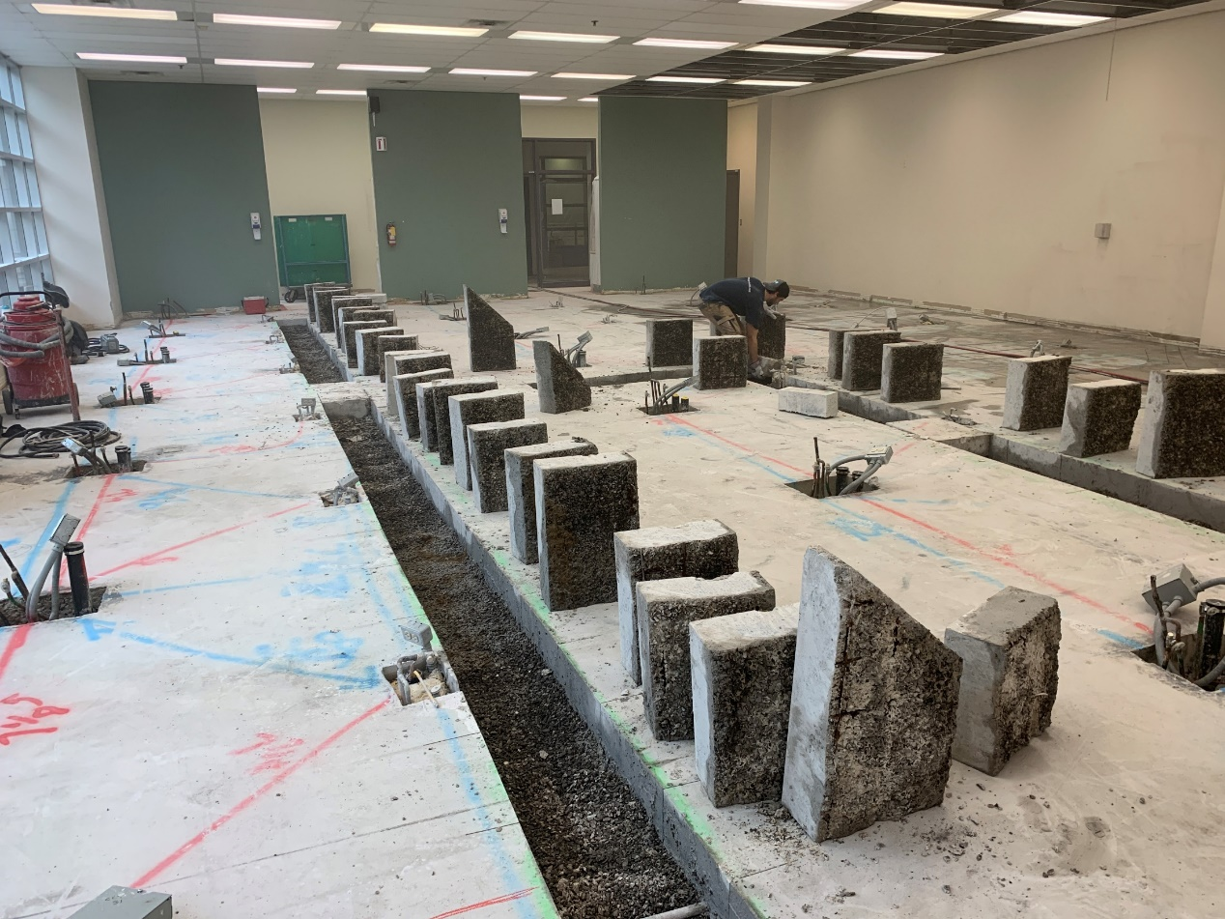
Dental Clinic Project
Replacing the suction system

Slide 6
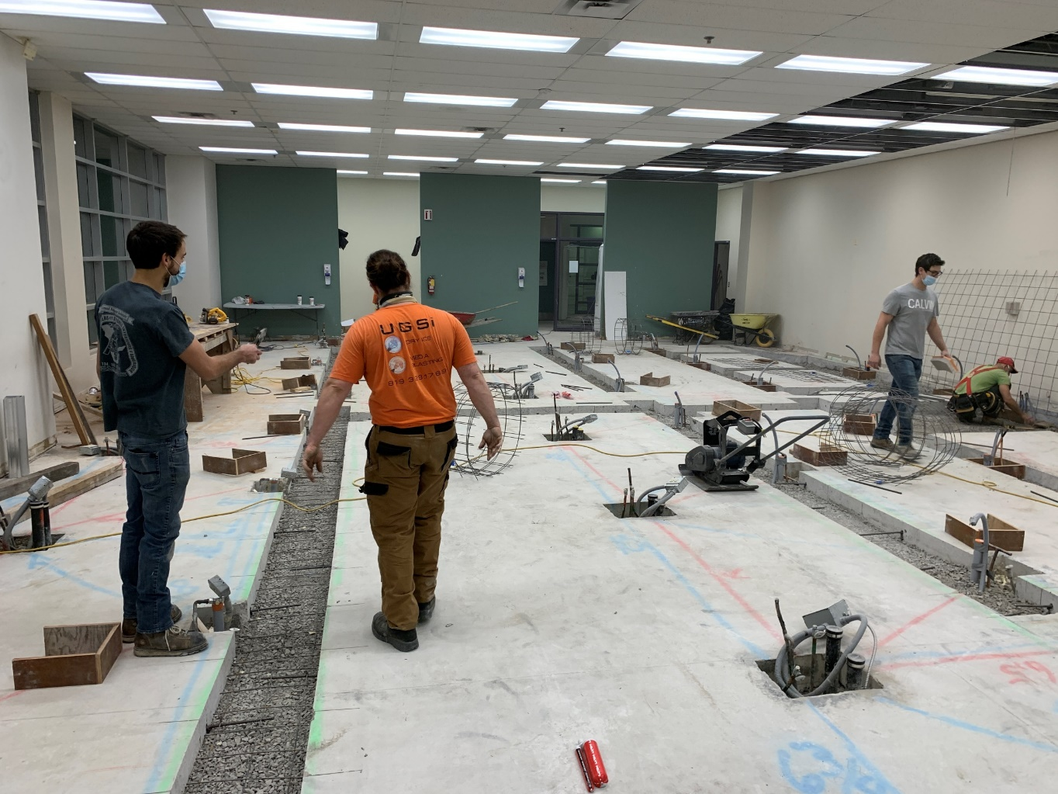
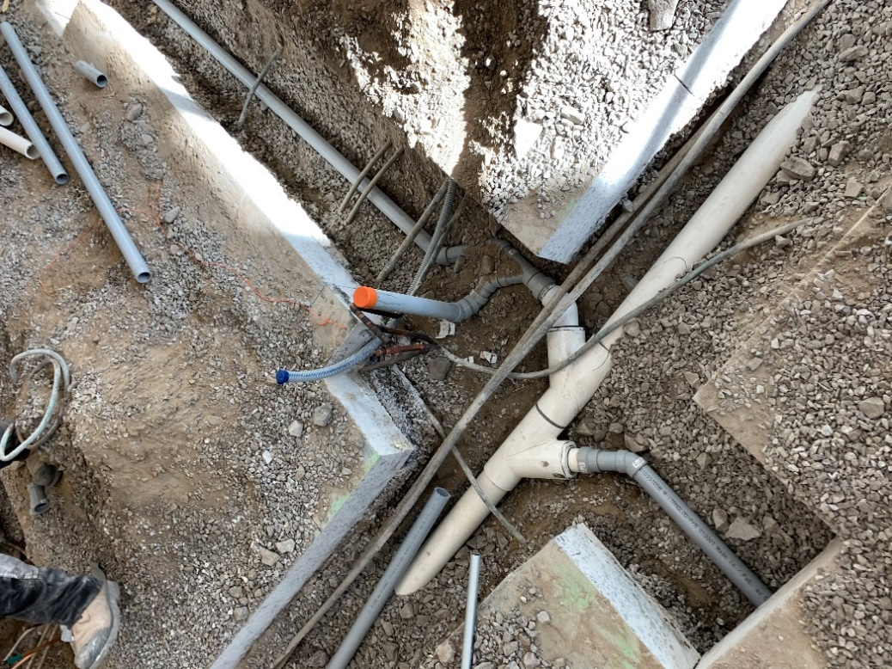
Dental Clinic Project
Replacing the suction system

Slide 7
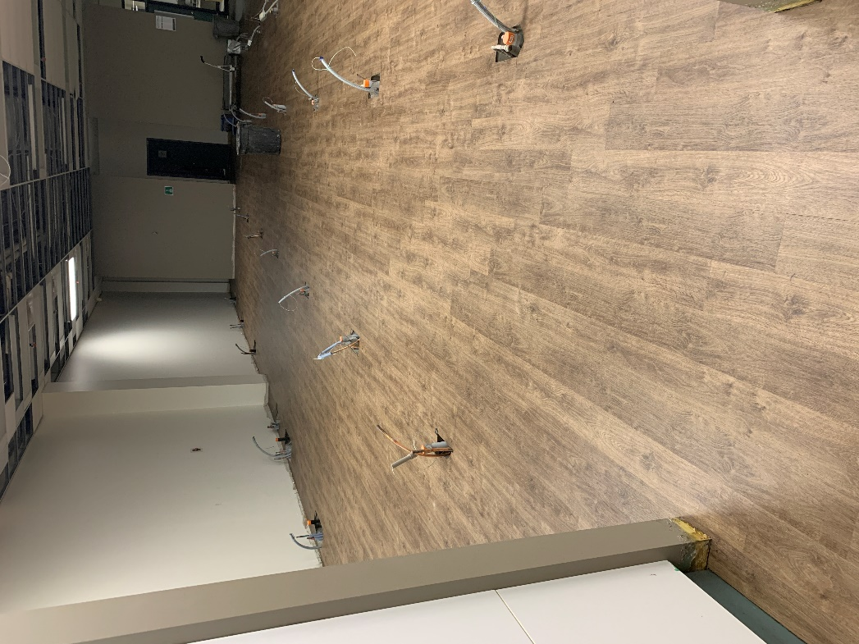
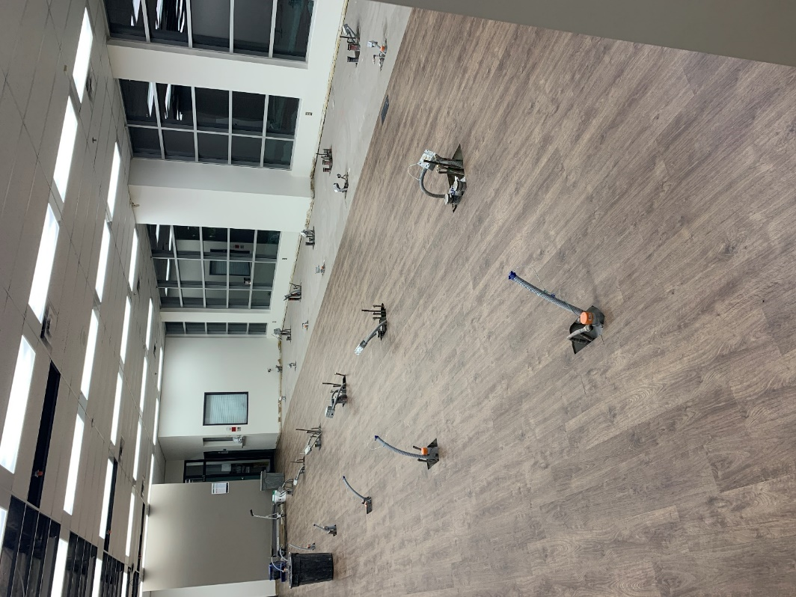
Dental Clinic Project
New floor wax free

Slide 8
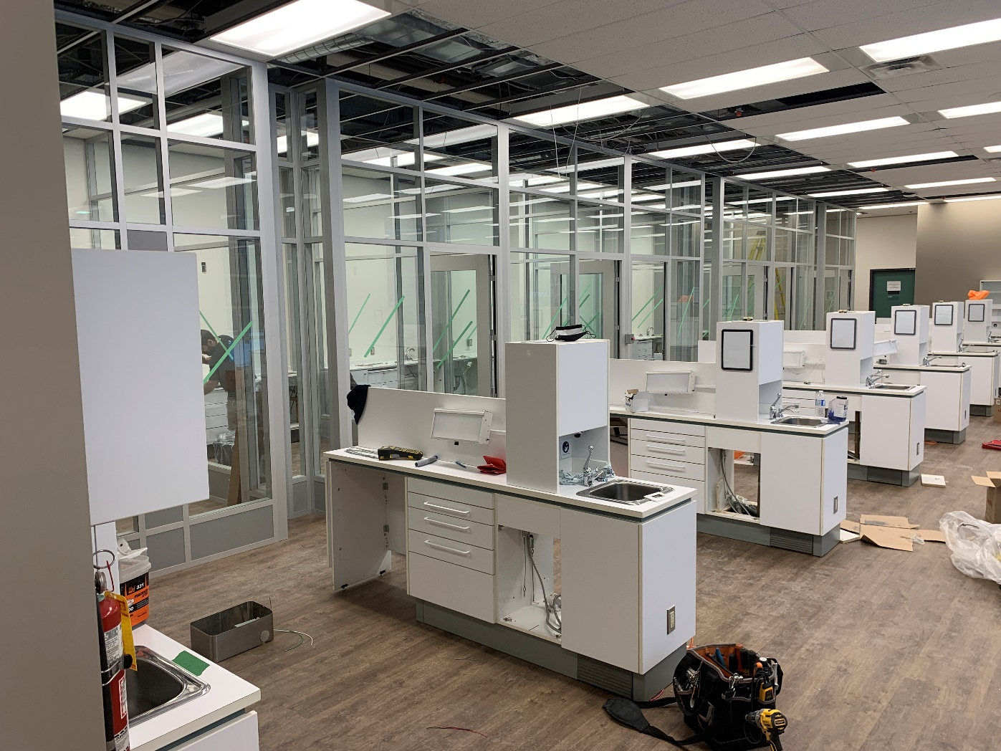
Dental Clinic Project
Prefabricated cubicle assembly

Slide 9
Dental Clinic Project
Ventilation and filtration system
Two dedicated heat pumps
6 to 7 air exchanges per hour
Return duct (not in the ceiling)
HEPA filtration units in each cabin -

Slide 10
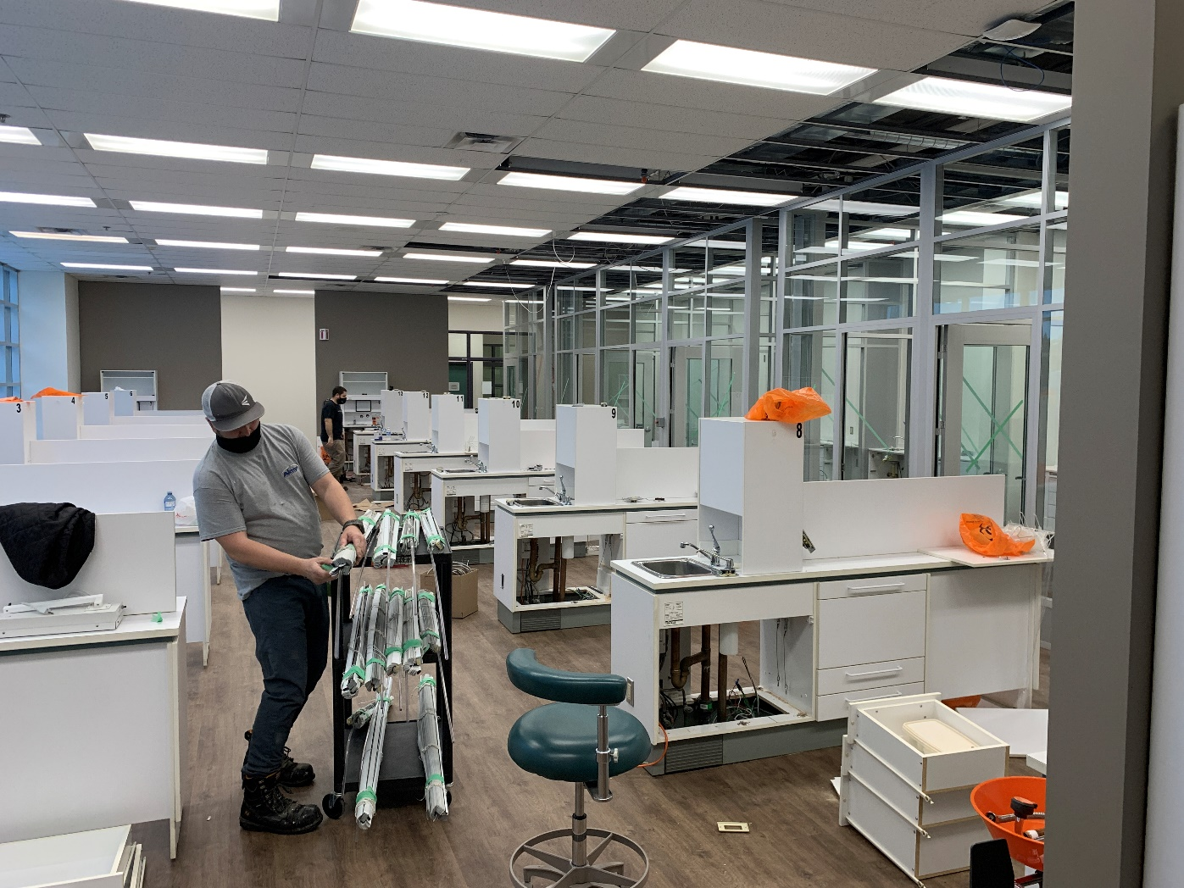
Dental Clinic Project
Reinstallation of existing cabinet

Slide 11
Dental Clinic Project
Challenges
Timeline: 9 weeks including the holiday season
Courses: continuously rescheduled
Noisy work
Gather the right partners
Costs

Slide 12
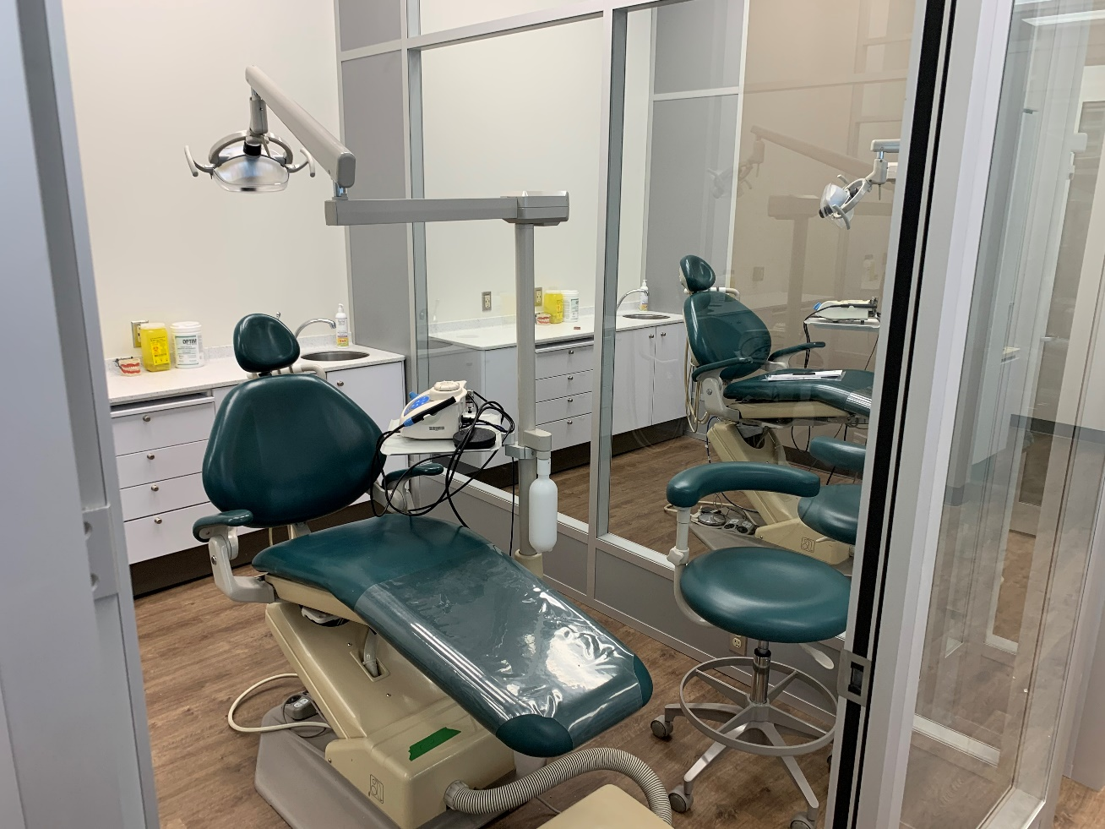
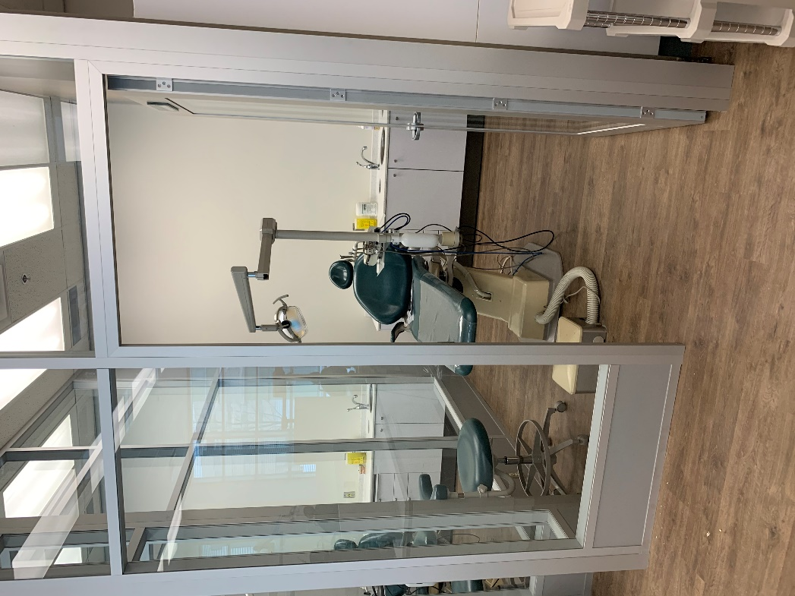
PROJET CLINIQUE DENTAIRE
Final Product

Slide 13
Dental Clinic Project
Things to fix
Old return air
Fire alarm
Noise in the cabins

Slide 14
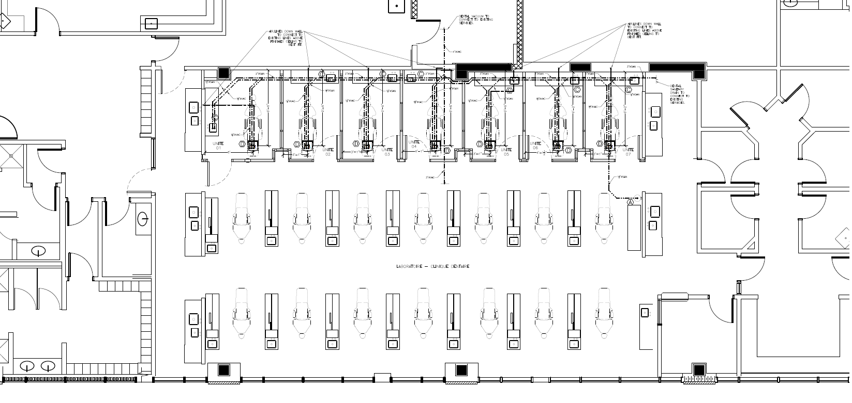
Dental Clinic Project
Final Layout

Slide 15
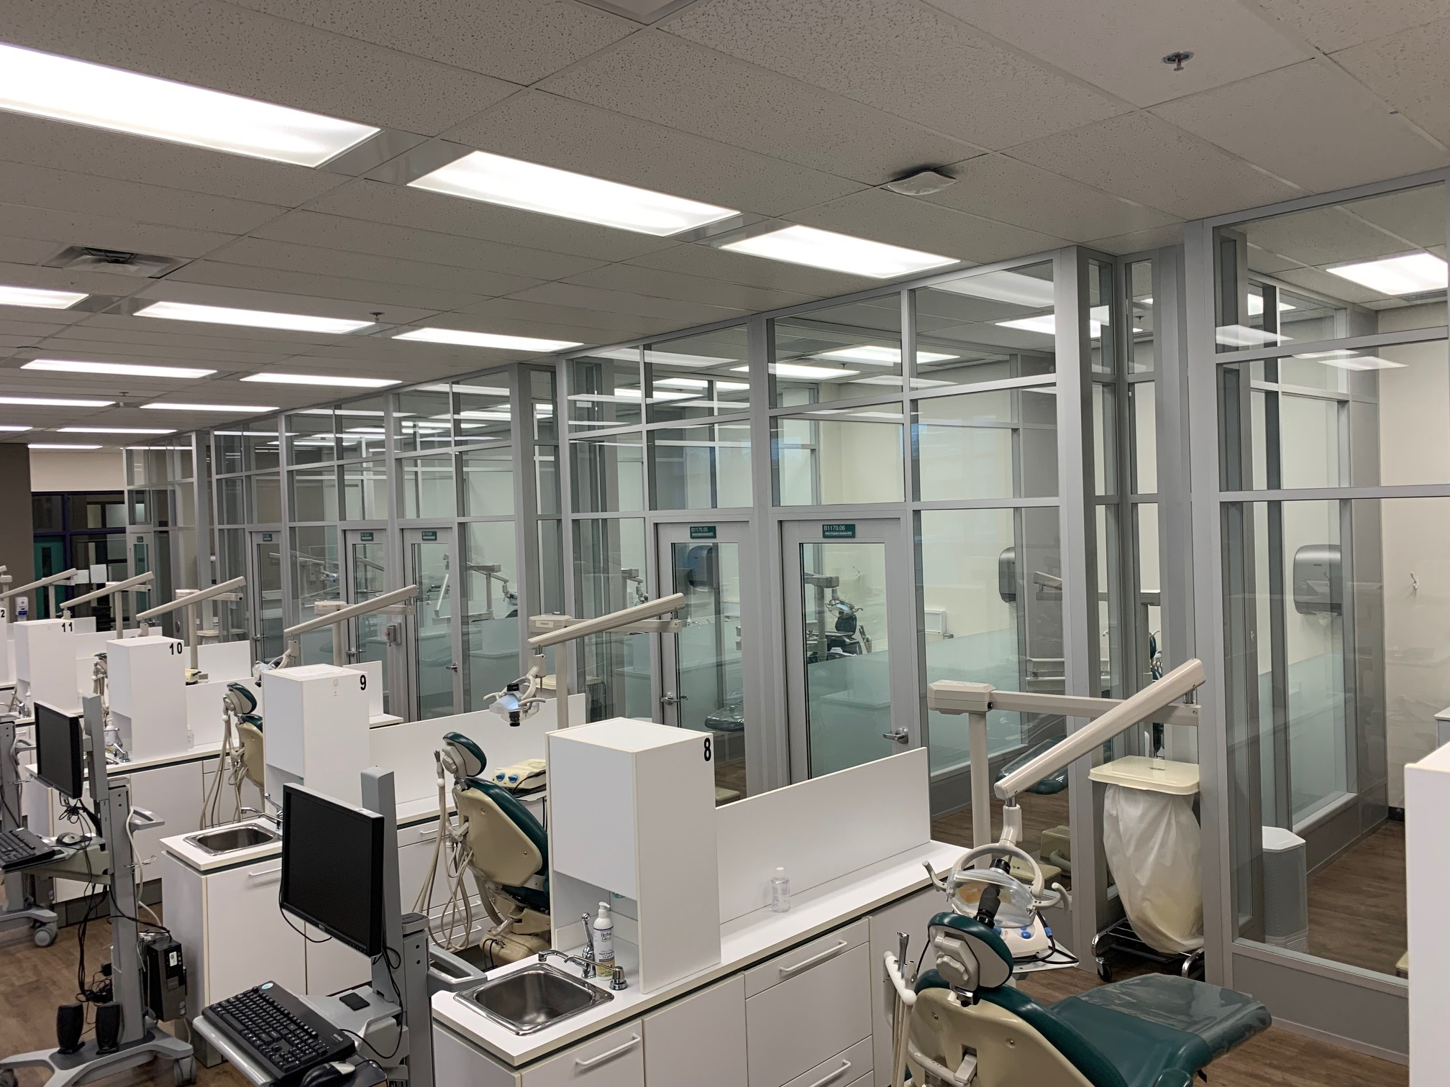
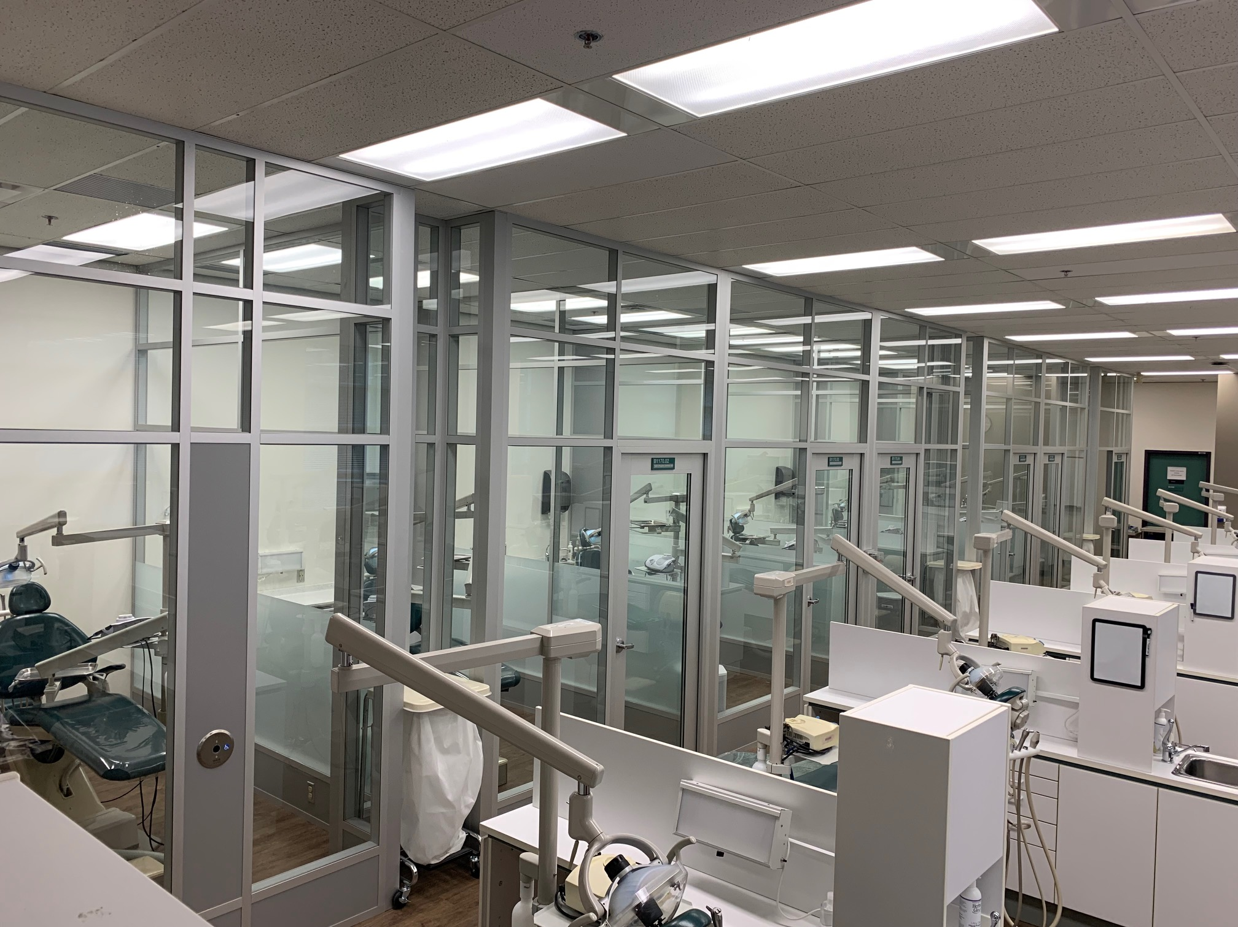
Dental Clinic Project
Final Layout

